Slide 1

Tech & Check Status Report
Chengkai Li
The University of Texas at Arlington
March 29, 2018

Slide 2

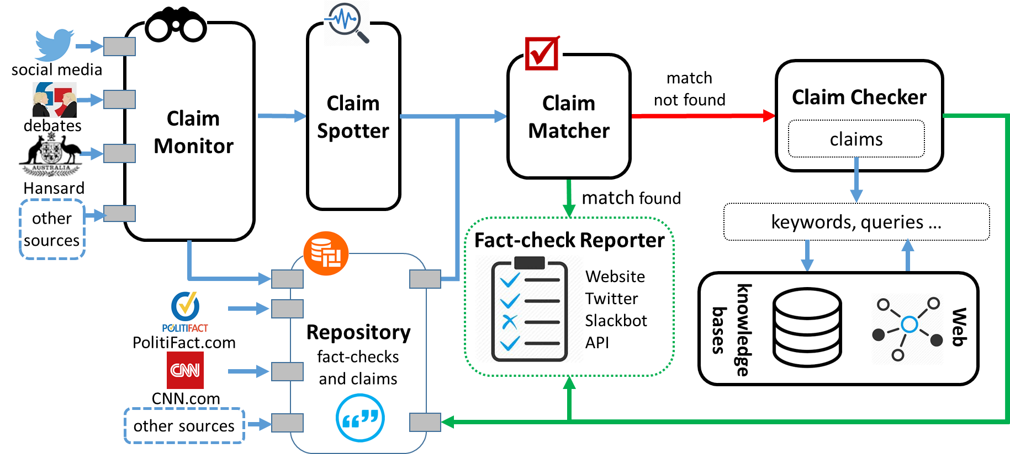
The First-ever End-to-end Fact-checking System
2

Slide 3
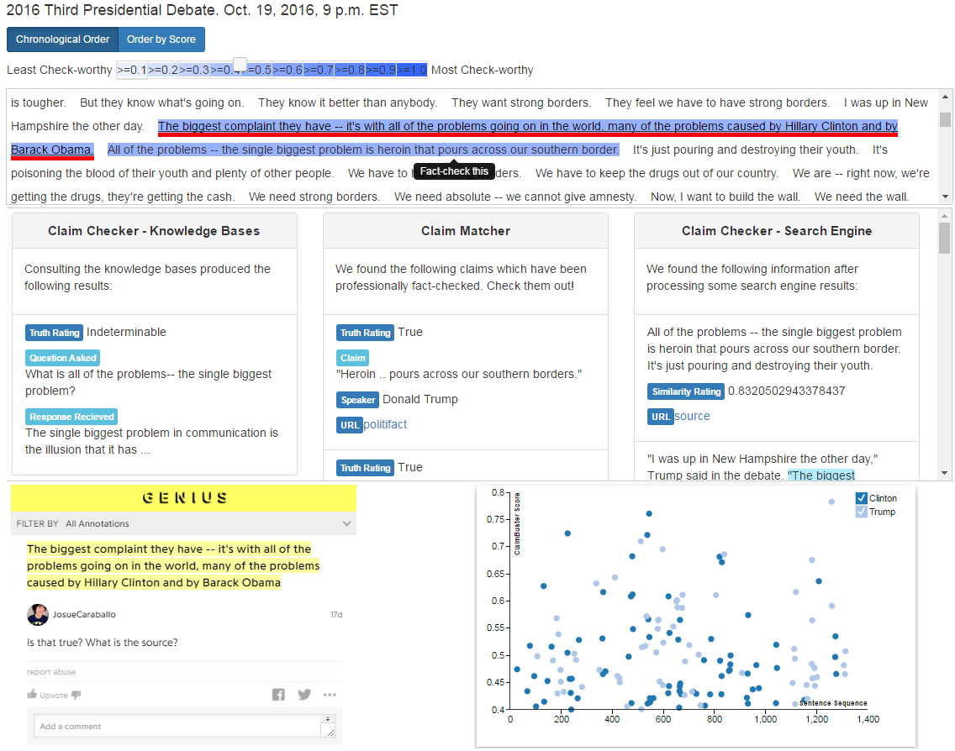
3

Slide 4
15

Slide 5

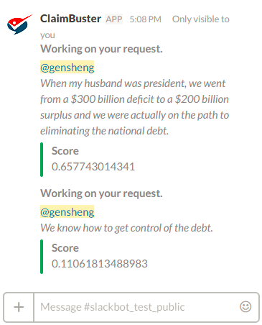
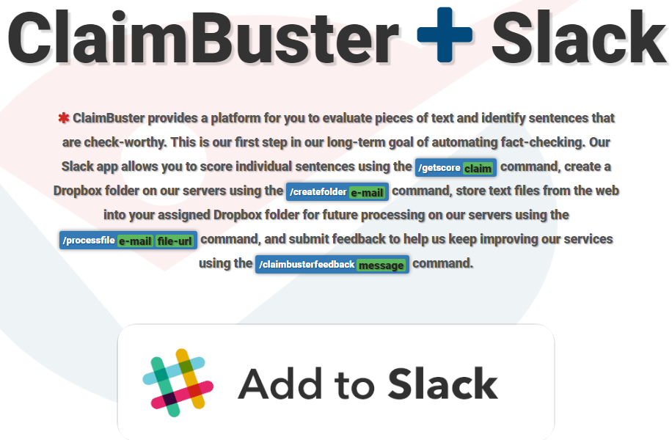
16

Slide 6
Ongoing work
Improving Claim Spotter Accuracy
Claim modeling: structured, semantic representation of factual claims
Claim matching
Claim-to-query translation

Slide 7
Classification Accuracy [IJCNN18]
Algorithm | Features | P NFS | P UFS | P CFS | P AVG* | R NFS | R UFS | R CFS | R AVG* | F NFS | F UFS | F CFS | F AVG*
SVM | Parts of Speech | 0.873 | 0.430 | 0.724 | 0.813 | 0.925 | 0.240 | 0.671 | 0.827 | 0.898 | 0.307 | 0.696 | 0.818
CNN | Google News¹ | 0.874 | 0.649 | 0.775 | 0.838 | 0.951 | 0.250 | 0.725 | 0.859 | 0.911 | 0.361 | 0.749 | 0.842
RNN | GLoVE² | 0.900 | 0.397 | 0.811 | 0.853 | 0.928 | 0.457 | 0.712 | 0.852 | 0.914 | 0.425 | 0.758 | 0.851
P: Precision | R: Recall | F: F1-Score
*: Average (AVG) is weighted based on the distribution of the number of labels in each class.
1: Pre-trained vectors trained on part of Google News dataset (about 100 billion words). The model contains 300-dimensional vectors for 3 million words and phrases. https://code.google.com/archive/p/word2vec/
2: Global Vectors for Word Representation using The Common Crawl corpus which contains petabytes of data collected over the last 7 years. https://nlp.stanford.edu/projects/glove/
7

Slide 8
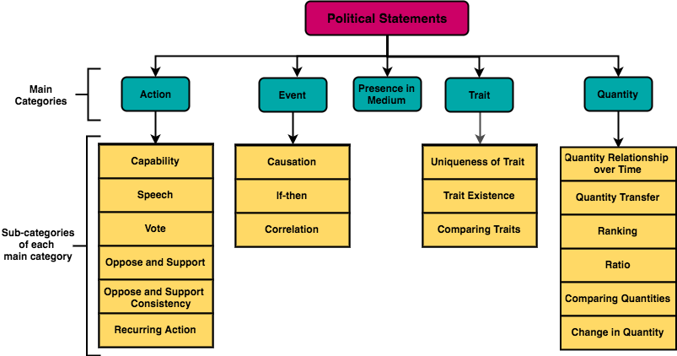
Notes:
This figure depicts our taxonomy hierarchy for political claims. This taxonomy assumes that a natural language claim belongs to one of five main categories: a claim regarding an action, a quantity, an event, a trait, or a presence in medium. Each of these categories (except presence in medium) contains various sub-categories which further separate the natural language claims.

Slide 9
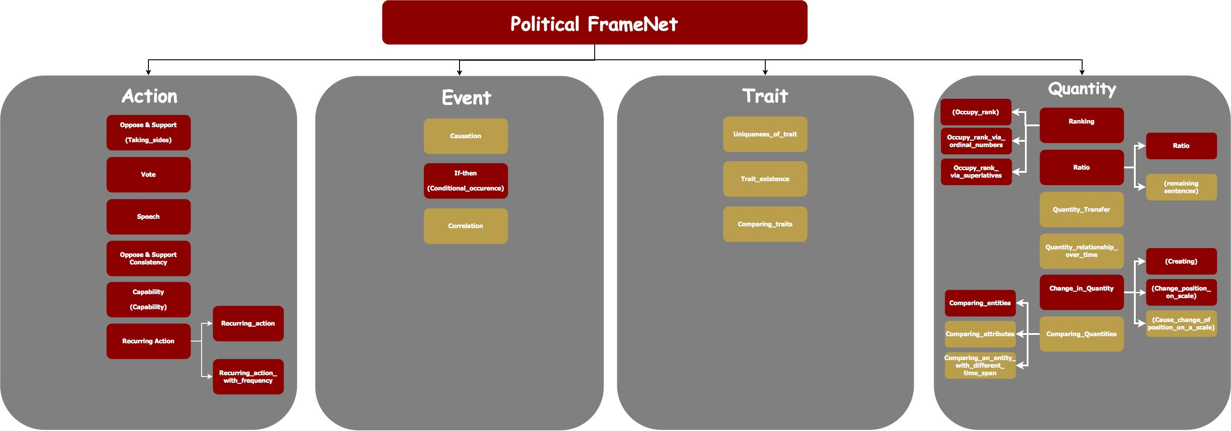
Notes:
The figure shows our Political FrameNet hierarchy. The red-colored blocks are completed frames. The name inside parentheses means that they are taken from FrameNet.

Slide 10
FrameNet
The Berkeley FrameNet project provides a lexicon of 1,222 semantic frames and a corpus of sentences annotated with frames.
Each frame represents a kind of event, situation, or relationship, and has a set of frame elements (semantic roles) associated with it [3].
In a sentence, frames are evoked by lexical units, which are words or phrases.

Slide 11
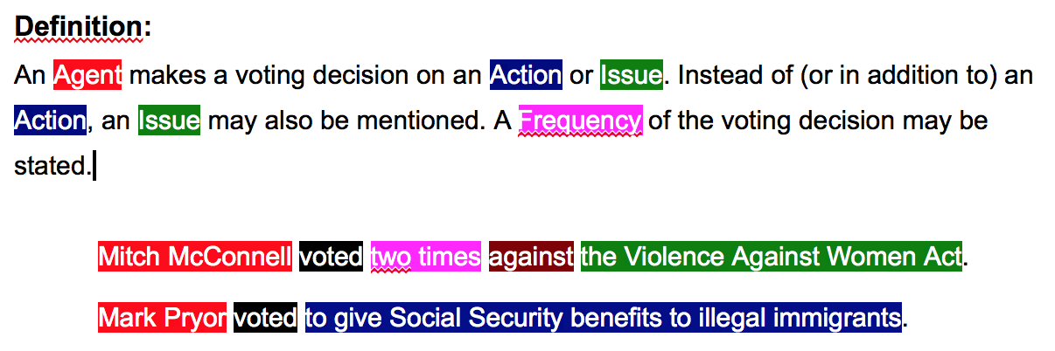
An Example Frame: Vote

Slide 12
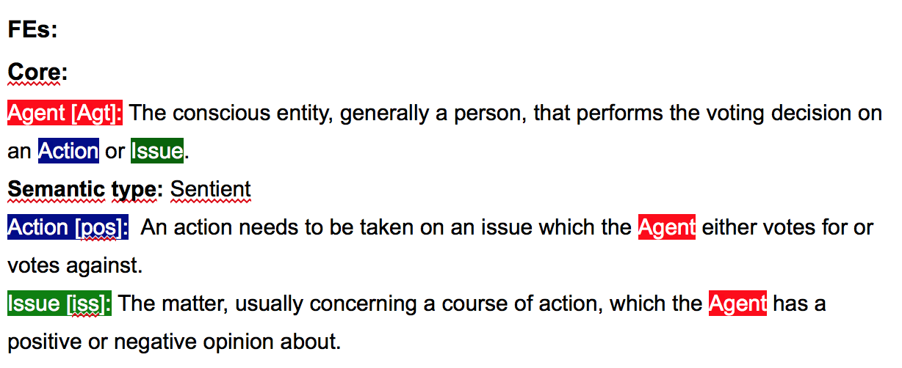
An Example Frame: Vote (cont.)
Notes:
FEs stands for frame elements.
Core frame elements have to be presented, but Non-Core frame elements are optional.

Slide 13
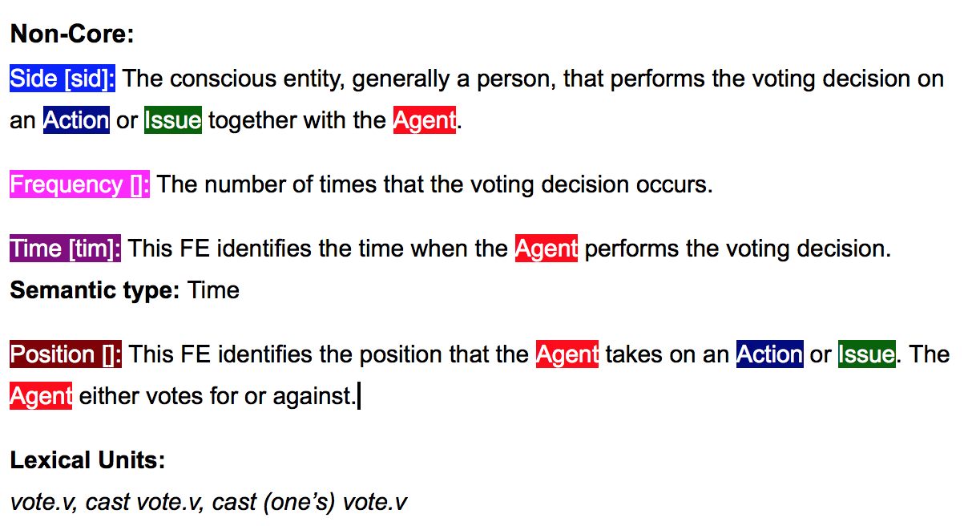
An Example Frame: Vote (cont.)
Notes:
The FrameNet lexicon maintains a list of lexical units for each frame, which are lemma and part-of-speech pairs that can evoke that frame.

Slide 14
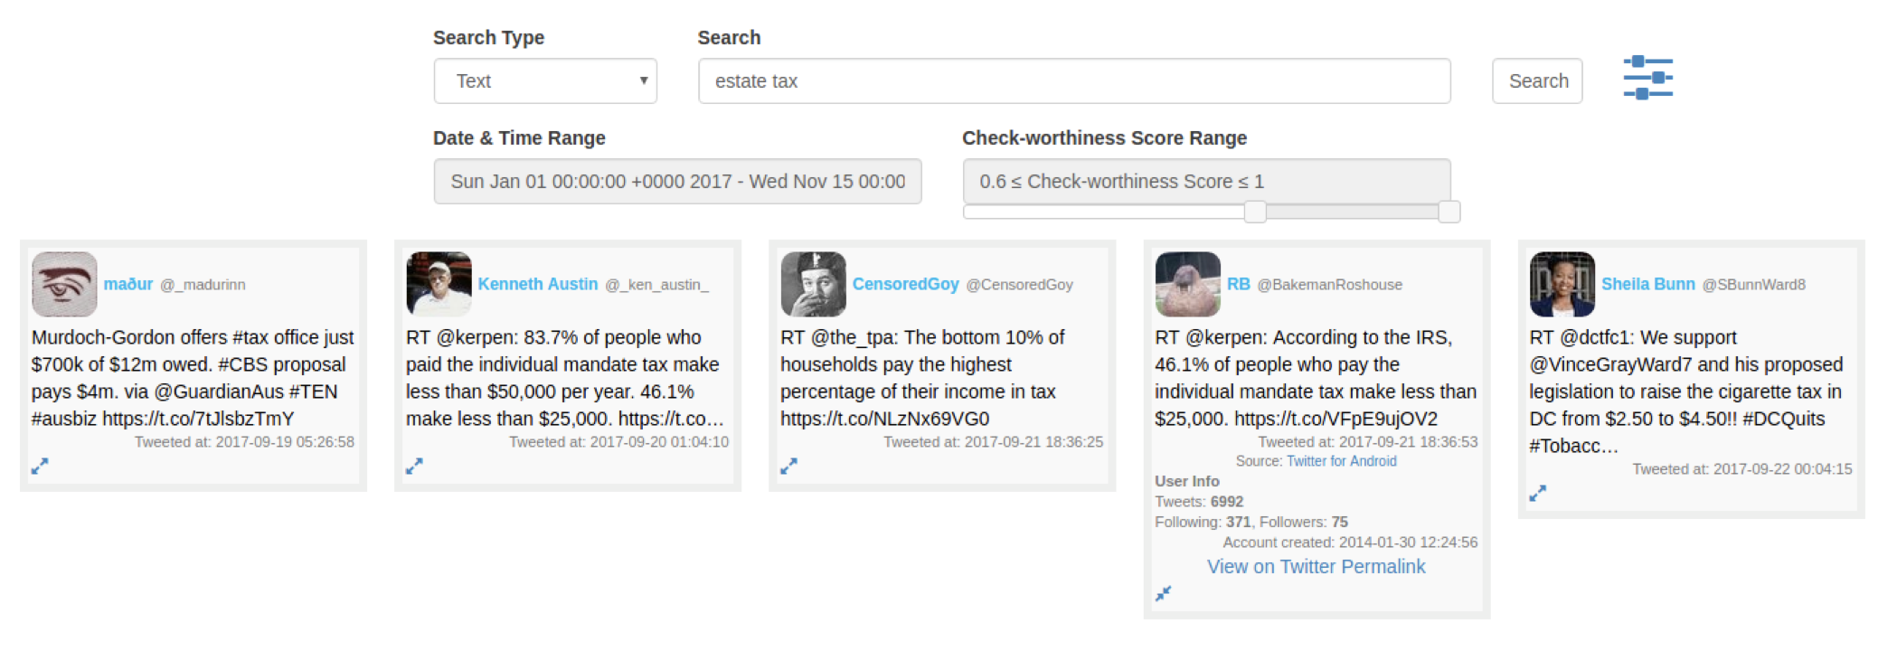
ClaimPortal: Monitoring, Search, Analytics of Factual Claims in Social Media

Slide 15
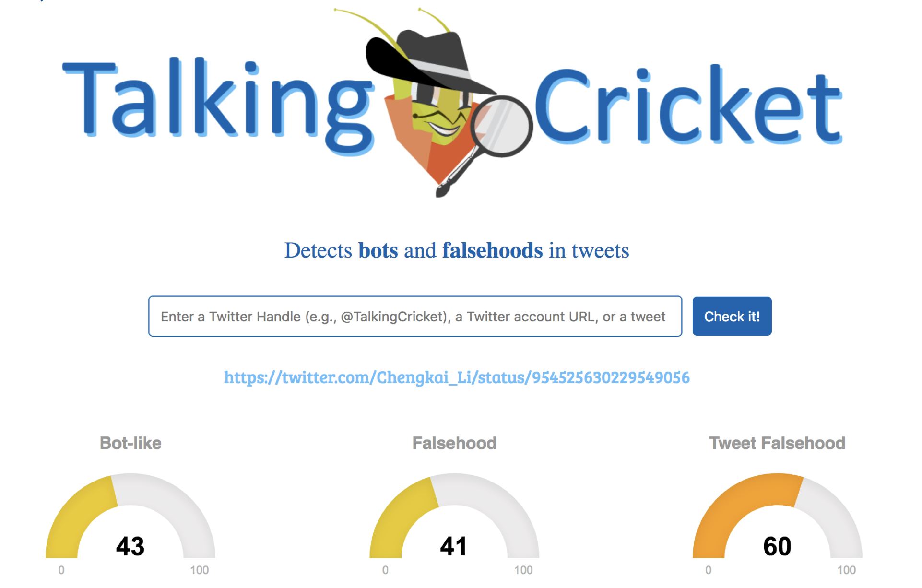
Botminator? Talking Cricket? (Hint: The Adventures of Pinocchio)

